Slide 1

Could we classify and how well the Cultivated Plants are with AI (Artificial Intelligence) technique
By Galina Kulya
A0223124
MSc Applied Artificial Intelligence
Notes:
Good Morning Ladies and Gentlemen
I am Galina Kulya – student at Teesside University
Today I present my research project For Master degree for Appl “…”.
In this presentation I want to discuss
Plant classification problem,
What techniques of Artificial Intelligence I can used for it solving
What I nave done
and, as a Result of my research, what need to be done in a future for a better result.

Slide 2

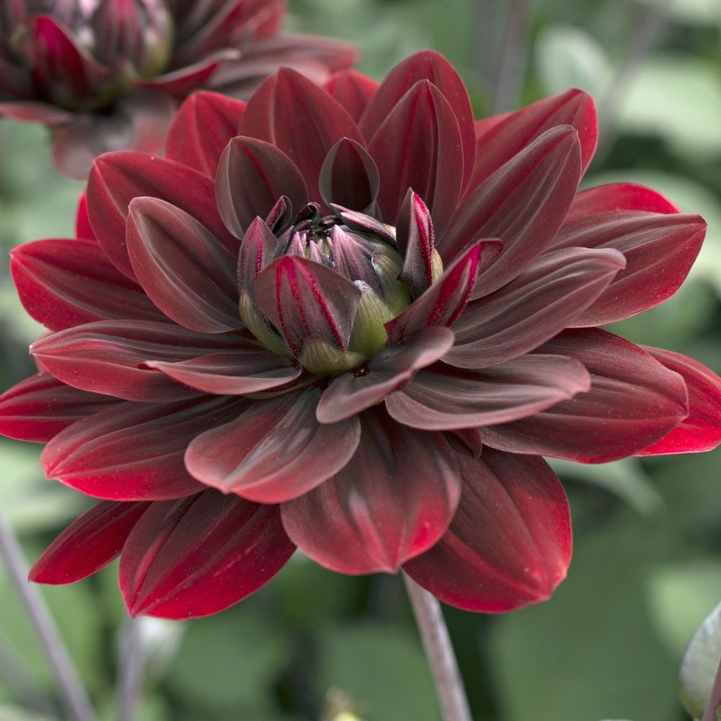
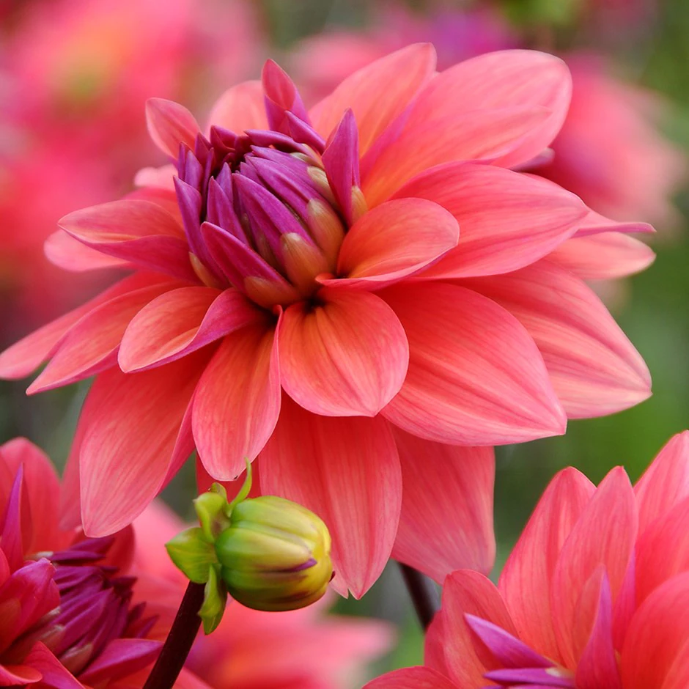

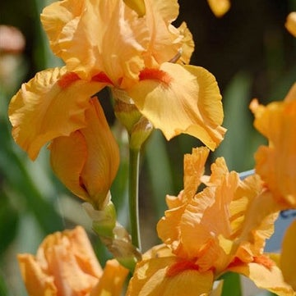
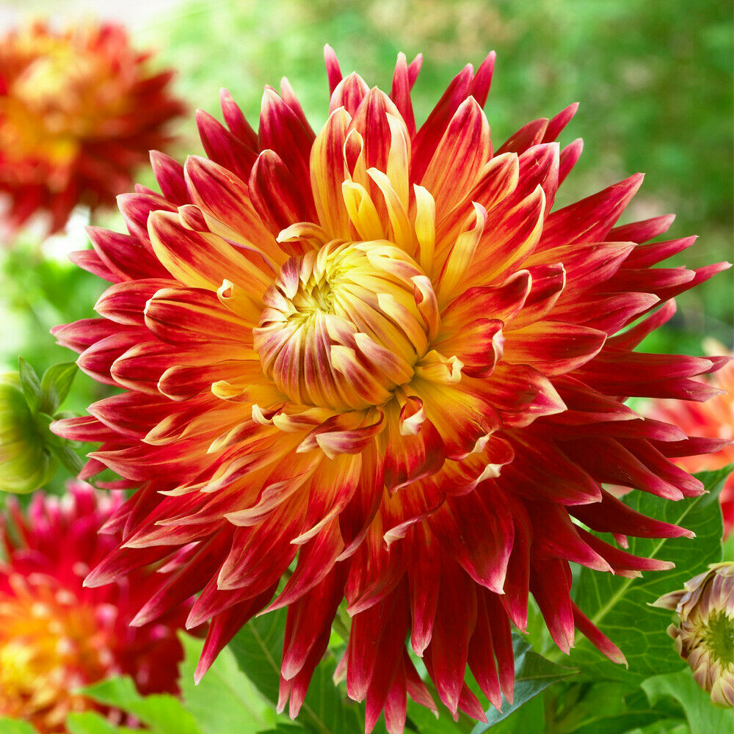
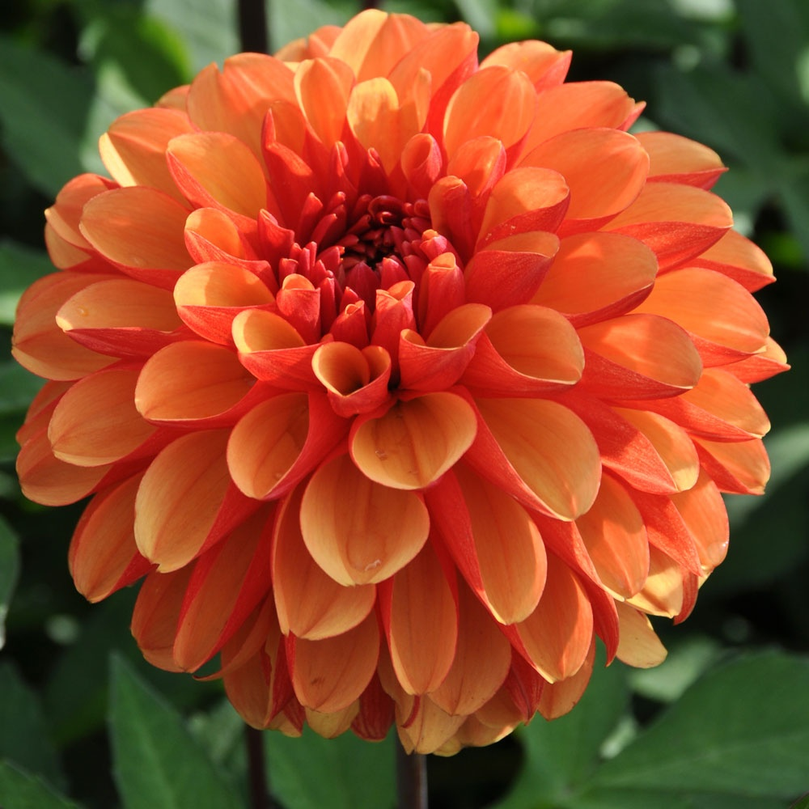
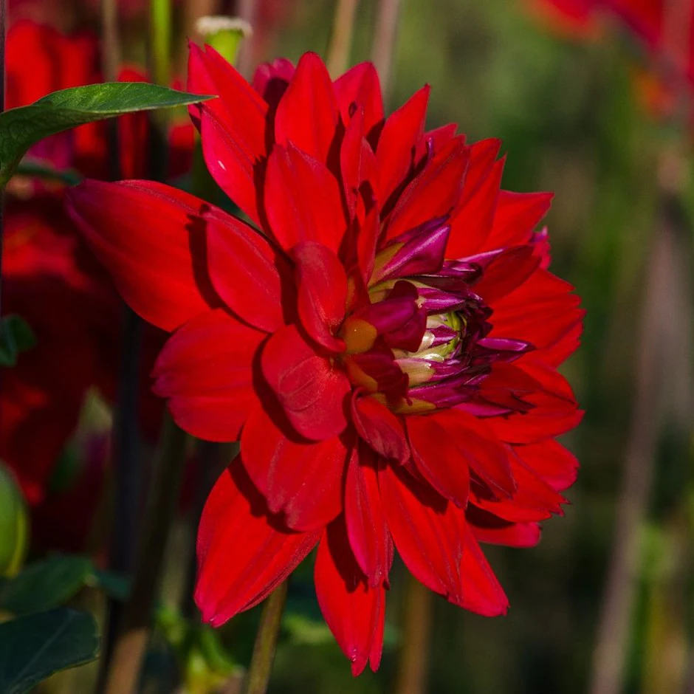
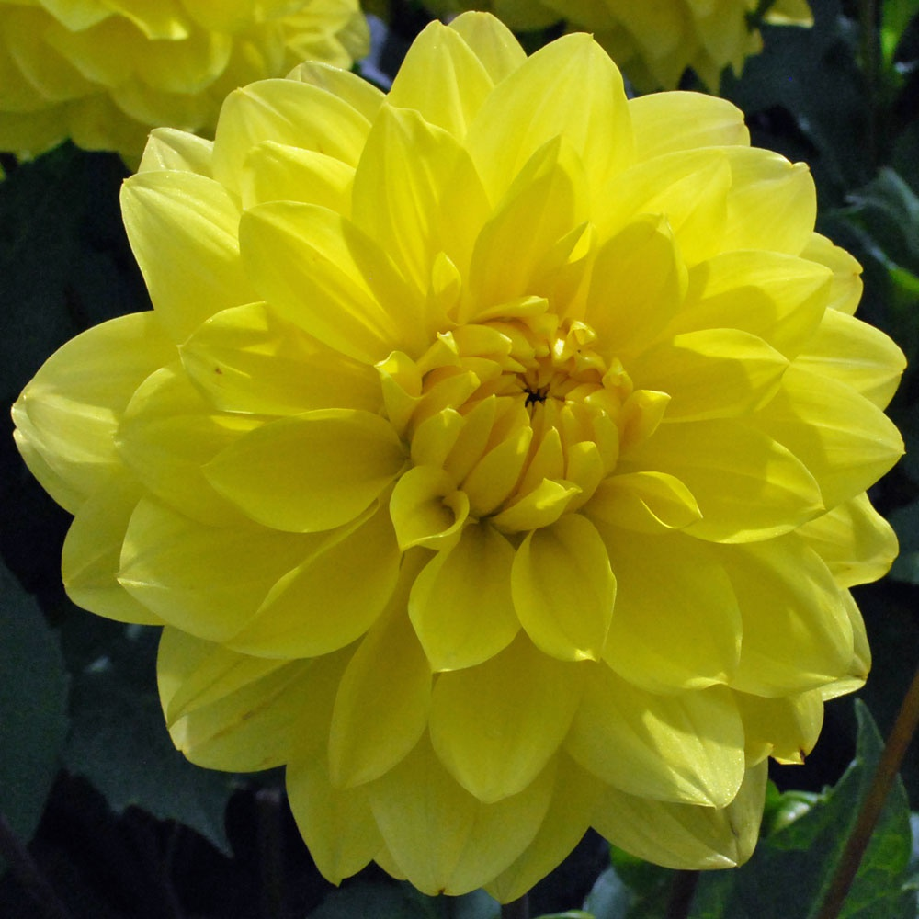
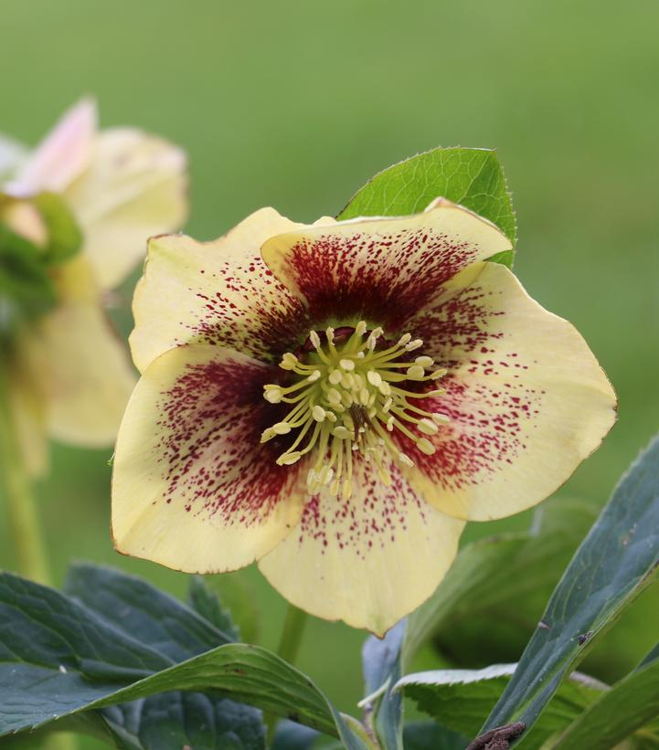
The Problem
Plant classification:
Class
Order
Family
Tribe
Genus
Species
Variety
Cultivar
Notes:
First of all, I want to identify the problem: The question was
How the common person (non-professional) could easy classify the plant if he had only plant image.
He could use some mobile app, but for now this app can classify to only maximum species, not cultivar name.
There are countless plant species in the world.
For that I decided to create a program for solving that problem and investigate
What need to be done to a good result.

Slide 3

Data sources
private images
open-source images
images from video
images from data augmentation
Notes:
For beginning I had to find the food for my machine - the data .
I couldn’t find the dataset which could contain not only plant species or genus but cultivar.
So, the data set had to be hand-crafted. The copyright law ought to be taken into consideration, so the images were collected from open internet sources only, such as Wikipedia, and from small private collections of photographs. Additionally, the video of plants was taken from plant nurseries and converted into separate . Jpg files with the Python program. This combined dataset was thoroughly revised and cleared. The cultivar that consists of just 1-3 images was deleted as it could not be correctly split between training and validation.
In order to increase the quantity of data, the Data Augmentation technique was implemented with the up-sampling method to avoid a severe issue with class imbalance.
The slightly distorting Cultivar images have been added up to 25 on average for each class.

Slide 4
Data structure
Data
Dahlia
01Dahlia ‘Akita’
59 Dalia ‘White Aster’
Helleborus
01 Helleborus ‘Anna’s Red’
Genus Name – 2 items
Cultivar Name – 66 items
07 Helleborus ‘Yellow Lady’
…..
…….
Photo files – 1501 items
…..
Helleborus ‘Anna’s Red’ 0001.jpg
…..
Helleborus ‘Yellow Lady’ 0001.jpg
Helleborus ‘Yellow Lady’ 0002.jpg
Helleborus ‘Anna’s Red’ 0002.jpg
Dahlia ‘Akita’ 0001.jpg
Dalia ‘White Aster’ 0001.jpg
Dahlia ‘Akita’ 0002.jpg
Dalia ‘White Aster’ 0002.jpg
Notes:
In view of the fact, that assembling a dataset is a very time-consuming procedure and with timing of the project being quite limited, the dataset only includes 2 genera Dahlia and Helleborus which includes 59 and 7 cultivars, respectively.
.
As a result, the dataset contains a total of 1501 cultivar images.
All images was correctly labeled and put in relevant folder.

Slide 5
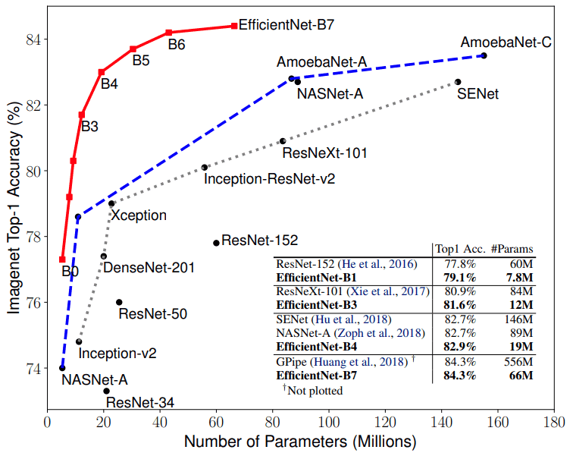
Selection of algorithms
DenseNet-201
Xception
Inception-ResNet-V2
EfficientNet-B7
Source: Complete Architectural Details of all EfficientNet Models
https://towardsdatascience.com/complete-architectural-details-of-all-efficientnet-models-5fd5b736142
Notes:
As selection of data is very important for a result as the selection of algorithms.
Since, I wanted to compare some algorithms for selection the one with better performance for my dataset,
inspiring by paper of Tan and Le,
“EfficientNet: Rethinking Model Scaling for Convolutional Neural Networks” from 2019).
After some deliberation
I chose the DenseNet201, Xception, InceptionRes-NetV2, EfficientNetB7 algorithms
as for different construction
as for the best relationship between number of parameters and accuracy.

Slide 6
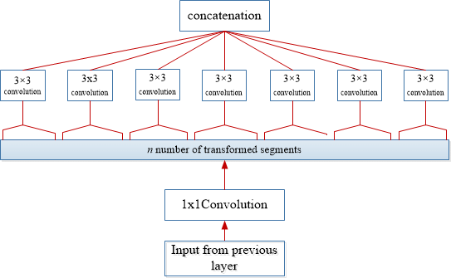
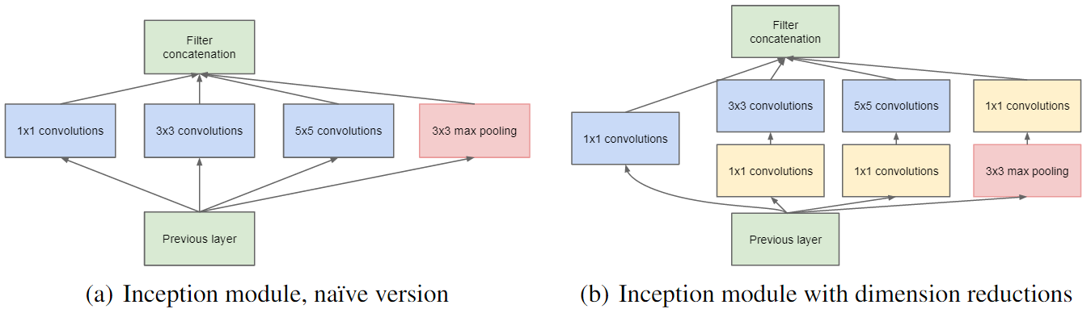
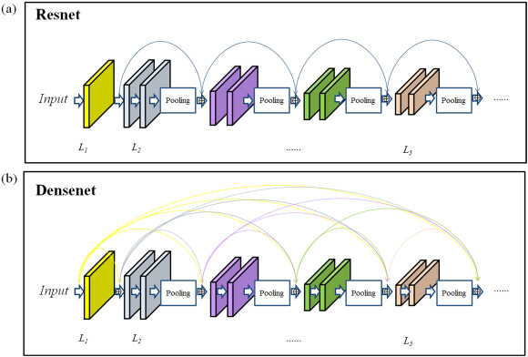
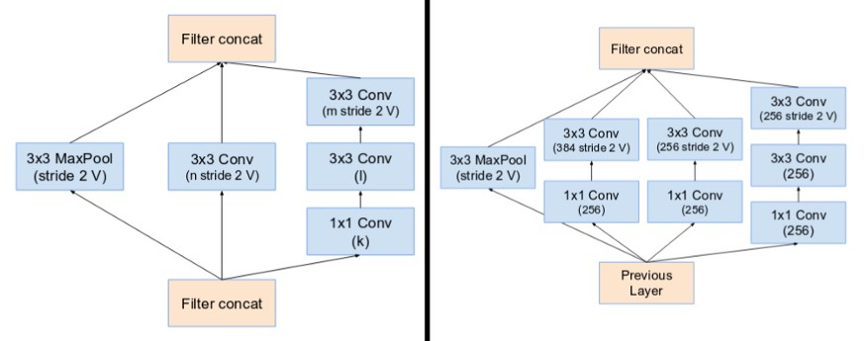
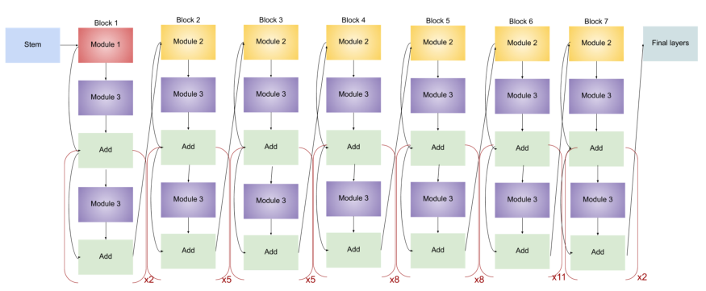
Basic building blocks of algorithms
Source: A Survey of the Recent Architectures of Deep Convolutional Neural Networks
https://www.researchgate.net/publication/330511306_A_Survey_of_the_Recent_Architectures_of_Deep_Convolutional_Neural_Networks
Xception is a deep convolutional neural network architecture that involves Depthwise Separable Convolutions
(From Left) Reduction Block A (35x35 to 17x17 size reduction) and Reduction Block B (17x17 to 8x8 size reduction). Refer to the paper for the exact hyper-parameter setting (V,l,k). (Source: Inception v4)
An inception network is a deep neural network with an architectural design that consists of repeating components referred to as Inception modules.
Source: A 3D densely connected convolution neural network with connection-wise attention mechanism for Alzheimer's disease classification https://www.sciencedirect.com/science/article/pii/S0730725X21000138
The layout of the ResNet (a) and DenseNet (b).
A residual neural network (ResNet) is an artificial neural network (ANN). Residual neural networks utilize skip connections, or shortcuts to jump over some layers. Typical ResNet models are implemented with double- or triple- layer skips that contain nonlinearities (ReLU) and batch normalization in between.(a)
A DenseNet is a type of convolutional neural network that utilises dense connections between layers, through Dense Blocks, where were connected all layers (with matching feature-map sizes) directly with each other. (b)
(From Left) Reduction Block A (35x35 to 17x17 size reduction) and Reduction Block B (17x17 to 8x8 size reduction). Refer to the paper for the exact hyper-parameter setting (V,l,k). (Source: Inception v4)
Inception-ResNet-v2 is a convolutional neural architecture that builds on the Inception family of architectures but incorporates residual connections (replacing the filter concatenation stage of the Inception architecture).
Source: Complete Architectural Details of all EfficientNet Models
https://towardsdatascience.com/complete-architectural-details-of-all-efficientnet-models-5fd5b736142
EfficientNet is a convolutional neural network architecture and scaling method that uniformly scales all dimensions of depth/width/resolution using a compound coefficient.
Notes:
Just briefly about basic blocks of algorithms:
An Inception module for each layer does a 5x5 convolutional transformation, and a 3x3, and a max-pool and concatenating their results into a single output. And the next layer of the model gets to decide if (and how) to use each piece of information. The naive Inception module just tripled or quadrupled the number of filters. In order to solve the computational bottleneck, the authors of Inception used 1x1 convolutions to “filter” the depth of the outputs.
Xception stands for “extreme inception.” it performs 1×1 convolution before any spatial convolutions.
ResNet for solving the degradation problem gives layers a “reference” point — x — to start learning from, learn the differences between the input and output , or the “residual.”
If the difference is not zero padding by 1×1 convolution used to get the matching size.
In Inception-ResNet-V2 module the residual blocks is applied in the Inception Network.
DenseNet: Densely Connected Convolutional Networks:
that utilises dense connections between layers, through Dense Blocks, where all layers were connected directly with each other (with matching feature-map sizes)
EfficientNet: proposed to achieved a balance in scaling all dimensions of network width/depth/resolution by constant ratio.

Slide 7
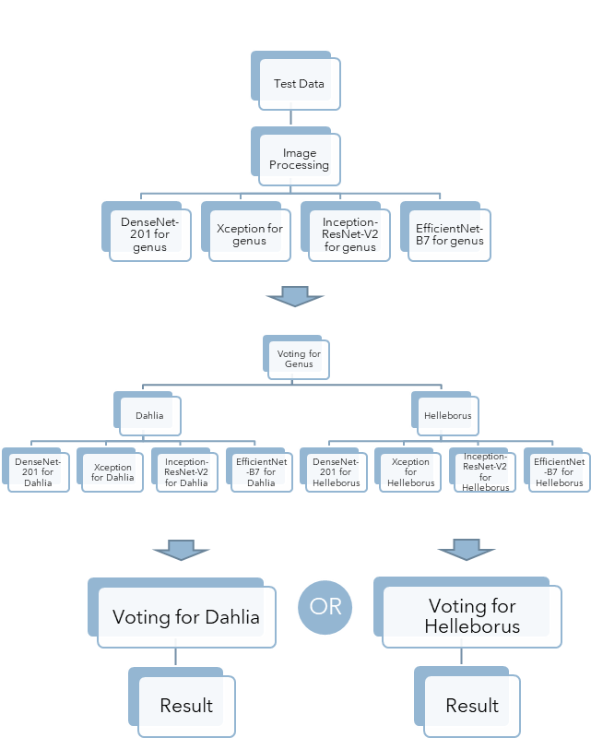
Method
Experiment 2
Experiment 1
Test Data
Image Processing
DenseNet-201 for cultivar
Xception for cultivar
Inception-ResNet-V2 for cultivar
EfficientNet-B7 for cultivar
Voting for Cultivar
Result
Notes:
The main stages of this research are:
1) First, the dataset of different plant flower was collected from various sources
2) Then, images were added by data augmentation
And split on train/validation and test datasets by 80/15/5%.
3) Next, four CNN algorithms are trained separately and compared on the basis of accuracy and loss, using the transfer learning-based approaches.
In total 16 models were saved: 4 CNN models for each of 4 classes - Genus, Cultivar, Dahlia, and Helleborus.
Then a models were evaluating on a test dataset in 2 experiments:
In 1 experiment by classifying the cultivar name of plants such as: Dahlia ’Fancy Pants’.
In comparison, in the second by classifying the same cultivar name out through previously classified genus name, such as, Dahlia or Helleborus. The results for genus was a little higher than for cultivar.

Slide 8
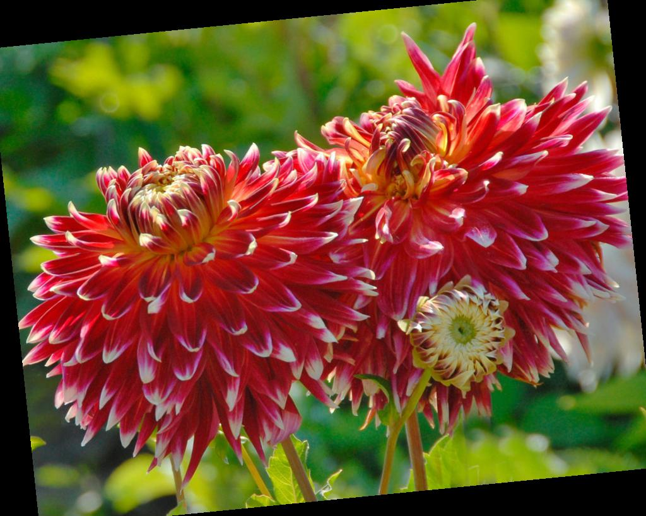
Experiment – sample of the code
Data augmentation:
Notes:
This is some code example:
On the left – it about the data augmentation; I used the horizontal flip, zoom in range of 10% and rotation by 15 degrees, the space was filling constant black.
On the right – I used the pre-trained on Imagenet dataset models with avg pooling, not including top layer for training.
It was added 2 Dense layer with activation ReLu, 2 Dropout layer with 50% of drop and 2 Batch Normalization layer,
Model was compiling with Adam optimizer with learning rate 0.001 and perform with Top-1 and Top-5 accuracy and loss function.

Slide 9
Comparison Results
DenseNet-201 model
Inception-ResNet-V2 model
 | Training Accuracy, % | Top 5 Training accuracy, % | Validation accuracy, % | Top 5 Validation accuracy, %
Cultivar | 24.6 | 60.19 | 49.47 | 90
Genus | 98.82 | 100 | 100 | 100
Dahlia | 21.44 | 56.93 | 51.18 | 84.71
Helleborus | 84.5 | 100 | 95 | 100
 | Training Accuracy, % | Top 5 Training accuracy, % | Validation accuracy, % | Top 5 Validation accuracy, %
Cultivar | 18.68 | 52.49 | 37.37 | 68.95
Genus | 97.72 | 100 | 100 | 100
Dahlia | 15.94 | 50.09 | 31.76 | 70.59
Helleborus | 65.12 | 100 | 85 | 100
Xception model
EfficientNet-B7 model
 | Training Accuracy, % | Top 5 Training accuracy, % | Validation accuracy, % | Top 5 Validation accuracy, %
Cultivar | 24.68 | 61.71 | 49.47 | 84.74
Genus | 98.9 | 100 | 100 | 100
Dahlia | 28.75 | 66.41 | 52.94 | 87.06
Helleborus | 84.5 | 100 | 100 | 100
 | Training Accuracy, % | Top 5 Training accuracy, % | Validation accuracy, % | Top 5 Validation accuracy, %
Cultivar | 1.86 | 8.88 | 2.63 | 10
Genus | 89.1 | 100 | 89.47 | 100
Dahlia | 2.56 | 11.01 | 2.94 | 10.59
Helleborus | 20.16 | 79.84 | 15 | 75
Notes:
Furthermore, comparing performance of each model for given corresponding task indicates that Cultivar with 66 classes outperform better then Dahlia with 59 classes by 3% on average.
The confusion matrixes show that the proposed DenseNet-201 and Xception models provide lesser false negative and false positive rate.
It clearly shows that the proposed models receive significantly
more accuracy and loss values if the number of
classes is small. When determine the genus class with 2
options the Dahlia or Helleborus the training and validation
accuracy convergence at significantly better speed and approaches
100%, which affirms that the model is overfitting
extremely quickly after 10 epochs. For more complicated tasks
as determining the Helleborus cultivar, name, class the result
is slightly lower as it contains 7 options, but model overfitting
later after the 15 epochs or more.
For task involving class
determination for 59 options of Dahlia and 66 options of
Cultivar the models are more likely to underfit with the Top-
1 accuracy fluctuating within 15.94% (Inception-ResNet-V2
model) - 28.75% (Xception model) accordantly. The Top-5
accuracy get increased to 50.09% - 66.41% for corresponding
models.
The most important findings are:
1) the recognition accuracy does not increase if a number of classes slightly decreases;
2) there is a linear relationship between class complexity and accuracy;
3) not all CNN models use their parameters with the same level of efficiency.

Slide 10
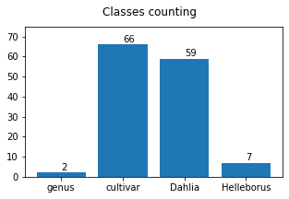
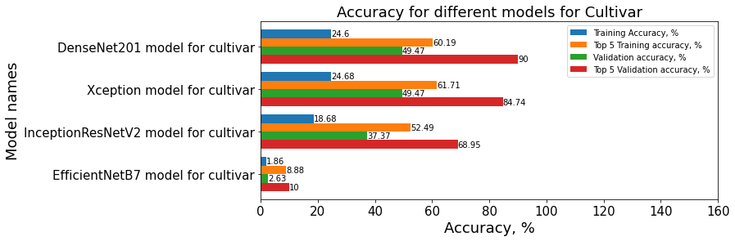
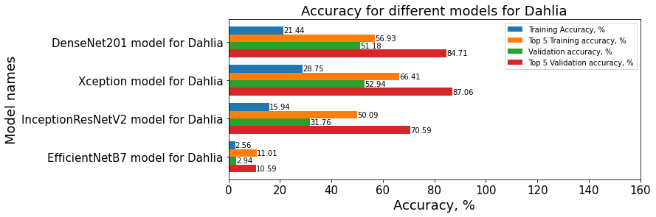
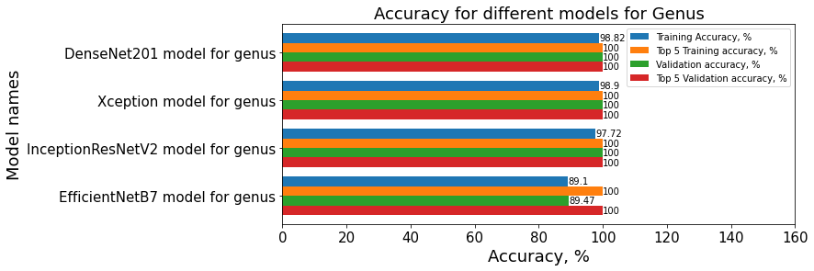
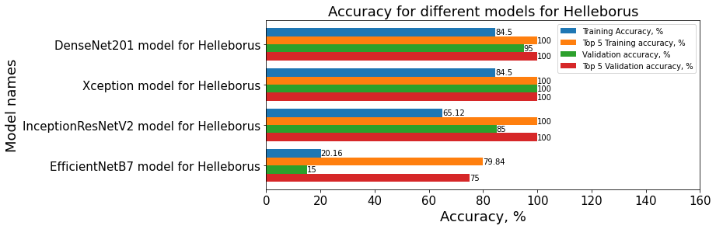
Accuracy for different models

Slide 11
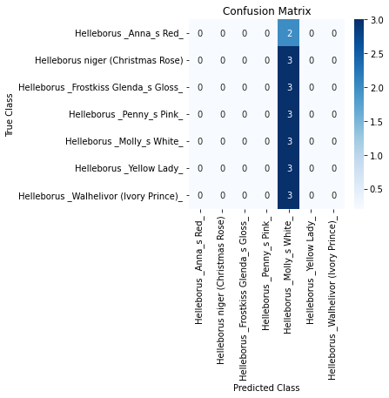
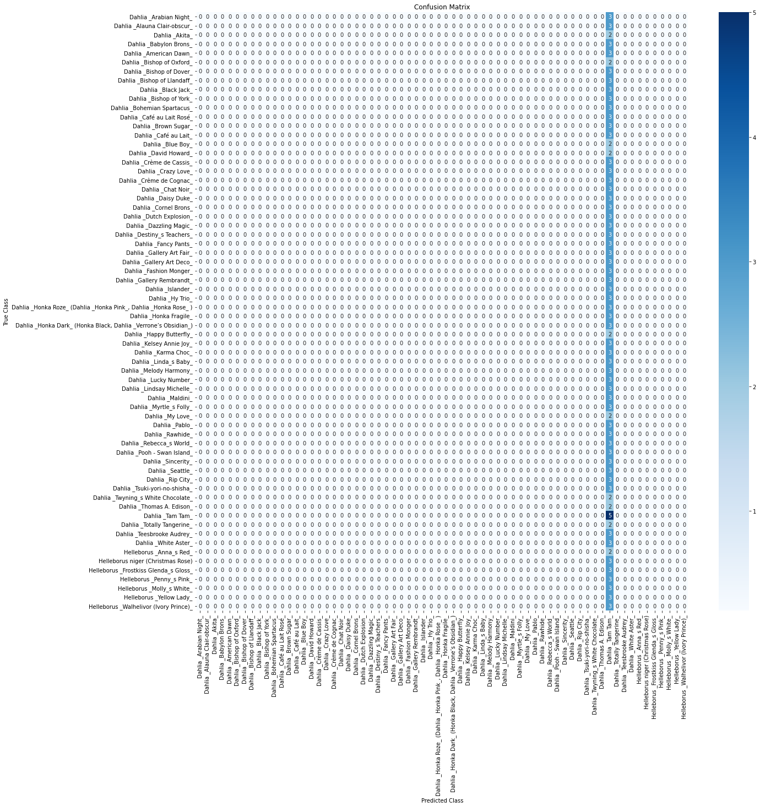
Anomalies: EfficientNet-B7 model
Confusion Matrix for
Helleborus
Confusion Matrix for cultivar
Notes:
The most important findings are: EfficientNet-B7 module achieves only 1.86% for Cultivar and 2.56% for Dahlia - two largest groups of classes and 20,16% for Helleborus classes with 89.1% for Genus class (7 and 2 classes in each group respectively).
This result was unpredictably and quite unclear.
In Confusion Matrix you can see that the prediction was done only for one plant.

Slide 12
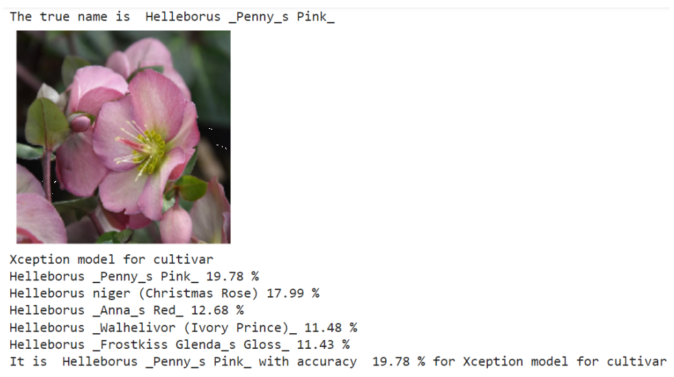
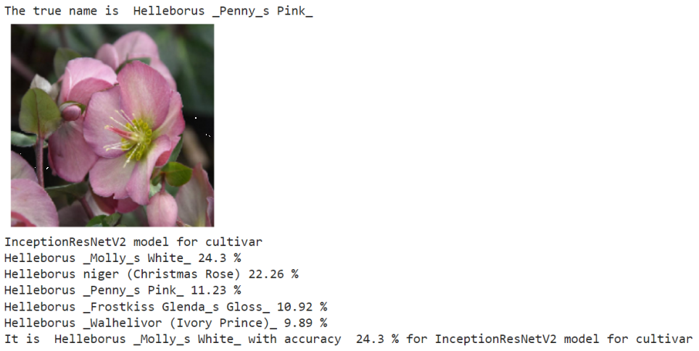


Prediction on a test set
The majority voting-based classifier ensemble
Xception model for cultivar
Inception-ResNet-V2 model for cultivar
Notes:
Evaluation of the majority voting-based method on the test dataset was done through two steps:
1) was found the probabilities from all 4 trained CNN models and collect in a table.
2) it was summed and sorted, only 5 of them with largest sum can be seen in the results.

Slide 13
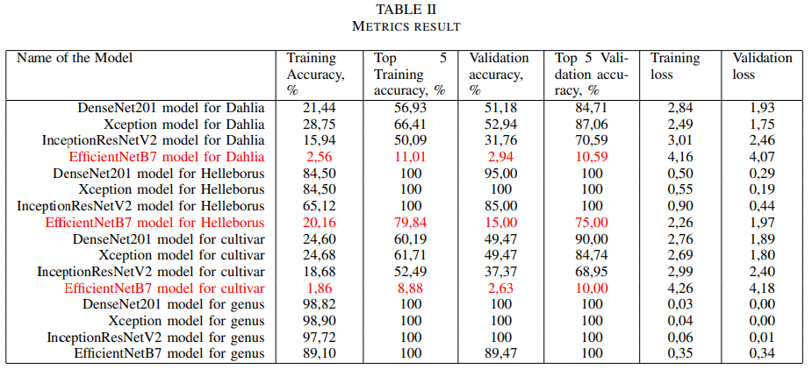
Summary
Notes:
The table depicts that the proposed method performed better in terms of overall accuracy. The prediction of cultivar name is better in finding the genus of that particular plant first.
As a conclusion: There are millions of plant species and cultivars in the world. For proper classification of them all,
an enormously powerful computer
and a thousand hour of training are required.
If human could
than and a machine could, the only question is When?
Need only do 3 steps :
The data – must be quantitative, competent and quality
The method – it is not only about selection of algorithm, but also about consolidated techniques
And Powerful equipment.
Experimental results show that the flower features are well learned and can be used for classifying flower images effectively with further improvement.

Slide 14

Thank you

